Slide 1
Lecture 15 Plots
Vaibhav N. Chunekar
25/08/2023

Slide 2
Agenda
Boxplot,
Quantile–Quantile Plot,
Scatter Plots/Pair-plot and
its limitations

Slide 3
Quantile–Quantile Plot

Slide 4
Quantile-Quantile Plot:Brief
Quantile plots, also known as quantile-quantile (Q-Q) plots, are important graphical tools used in statistics and data analysis.
They are used to assess the distributional similarity between two datasets, usually one empirical dataset and one theoretical distribution (like the normal distribution).

Slide 5
Quantile–Quantile Plot
The quantile-quantile plot is a graphical method for determining whether two samples of data came from the same population or not.
A q-q plot is a plot of the quantiles of the first data set against the quantiles of the second data set.
By a quantile, we mean the fraction (or percent) of points below the given value.
For the reference purpose, a 45% line is also plotted, if the samples are from the same population then the points are along this line.

Slide 6
Percentiles and Quantiles
The k-th percentile of a set of values divides them so that k % of the values lie below and (100 − k)% of the values lie above.
The 25th percentile is known as the lower quartile.
The 50th percentile is known as the median.
The 75th percentile is known as the upper quartile.
It is more common in statistics to refer to quantiles. These are the same as percentiles, but are indexed by sample fractions rather than by sample percentages.

Slide 7
Some Difficulties
The previous definition of quantiles and percentiles is not completely satisfactory. For example, consider the six values:
3.7 2.7 3.3 1.3 2.2 3.1
What is the lower quartile of these values?
There is no value which has 25% of these numbers below it and 75% above.
To overcome this difficulty we will use a definition of percentile which is in the spirit of the above statements, but which (necessarily) makes them hold only approximately.

Slide 8
Defining Quantiles
We define the quantiles for the set of values:
3.7 2.7 3.3 1.3 2.2 3.1
First sort the values into order:
1.3 2.2 2.7 3.1 3.3 3.7
Associate the ordered values with sample fractions equally spaced from zero to one.
Sample fraction | 0 | .2 | .4 | .6 | .8 | 1
Quantile | 1.3 | 2.2 | 2.7 | 3.1 | 3.3 | 3.7

Slide 9
Computation of Quartile
The lower quartile corresponds to a sample fraction of .25.
This lies one quarter of the way between .2 and .4.
The lower quartile must then be
=.75 × 2.2 + .25 × 2.7
= 2.325.

Slide 10
Defining Quantiles
The other quantiles of
1.3 2.2 2.7 3.1 3.3 3.7
can be obtained by linear interpolation between the values of the table.
The median corresponds to a sample fraction of .5. This lies half way between 0.4 and 0.6.
The median must thus be
.5 × 2.7 + .5 × 3.1 = 2.9

Slide 11
Steps used to draw QQ Plot
Sort Your Data: Arrange your dataset in ascending order.
Choose a Theoretical Distribution: Decide on the theoretical distribution you want to compare your data against
Calculate Quantiles: Calculate the quantiles for both your dataset and the theoretical distribution.
Create Scatter Plot: Plot the quantiles of your dataset against the quantiles of the theoretical distribution. Each data point corresponds to a quantile pair.
Add Reference Line: Draw a reference line on the plot

Slide 12
Computing the Median and Quartiles
●
3.5
●
●
3.0
Quantile
●
2.5
●
2.0
1.5
●
0.0 0.1 0.2 0.3 0.4 0.5 0.6 0.7 0.8 0.9 1.0
Sample Fraction

Slide 13

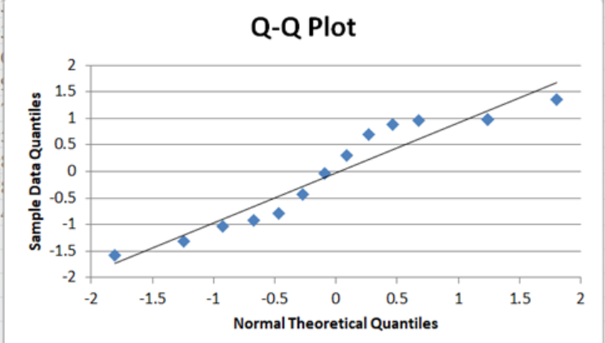
Another Example

Slide 14
Importance of Q-Q Plot
Distribution Comparison:
Quantile plots allow you to visually compare the quantiles of your data against the quantiles of a theoretical distribution.
This is especially useful when you want to check if your data follows a specific distribution, like the normal distribution.
If the points on the quantile plot closely follow a straight line, it indicates that your data's distribution is similar to the theoretical distribution.

Slide 15
Importance of Q-Q Plot
Identifying Deviations from Normality:
For instance, in the case of the normal distribution, if the points deviate significantly from the straight line in certain regions of the plot, it suggests that your data's distribution deviates from normality in those regions.
This can be a helpful initial step in identifying potential outliers or skewness in your data.

Slide 16
Importance of Q-Q Plot
Validity of Assumptions:
In statistical analyses, assumptions about the distribution of data are often made, especially in parametric tests like t-tests and ANOVAs.
Quantile plots can help you assess the validity of these assumptions.
If your data departs significantly from the expected distribution in the quantile plot, it might indicate that the assumptions of the statistical test might not be met.

Slide 17
Importance of Q-Q Plot
Data Cleaning and Transformation: Quantile plots can assist in identifying outliers or extreme values that might be affecting the distribution of your data.
If you notice deviations from the expected line in the quantile plot, you might want to investigate those points to determine if they are erroneous or require further investigation.

Slide 18
Importance of Q-Q Plot
Model Validation: In regression analysis, quantile plots can be used to validate the assumptions of homoscedasticity and normality of residuals. If the residuals of a regression model are normally distributed and have constant variance, the quantile plot of residuals should be roughly linear.

Slide 19
Importance of Q-Q Plot
Robustness of Results: Quantile plots provide a visual way to assess the robustness of your results to assumptions about the data distribution. If your conclusions or inferences are consistent across different data transformations, it adds to the credibility of your findings.

Slide 20
Importance of Q-Q Plot
Communication: Quantile plots are easy to interpret and can be used to effectively communicate insights to non-technical audiences.
A clear deviation from the theoretical distribution in a quantile plot can indicate the presence of interesting patterns or anomalies in the data.

Slide 21
Limitation of QQ Plots
Quantile-Quantile (QQ) plots are a powerful tool for assessing the distributional similarity between datasets, but they also have some limitations that experts should be aware of:
Sample Size Dependence: QQ plots can be sensitive to sample size, particularly for small datasets. With a small number of data points, it can be challenging to detect subtle deviations from the theoretical distribution. As the sample size increases, the plot becomes more informative and reliable.

Slide 22
Limitation of QQ Plots
Limited to One Distribution: QQ plots are designed to compare the empirical distribution of data to a single theoretical distribution. They might not be suitable for comparing data to multiple distributions simultaneously or for assessing the fit to complex, non-parametric distributions.
Subjective Interpretation: While QQ plots provide a visual assessment of distributional fit, the interpretation can be somewhat subjective. Determining whether deviations from the diagonal line are significant or not might require additional statistical tests or expertise.

Slide 23
Limitation of QQ Plots
Inaccurate for Heavy Tails: In cases where distributions have heavy tails (e.g., distributions with extreme values or outliers), the tails might not be accurately represented in a QQ plot. This can lead to misleading assessments of fit in the tails.
Specific to Quantiles: QQ plots focus on the quantiles of the data, which might not capture the full picture of distributional differences, especially if the deviations occur in regions between quantiles.

Slide 24
Limitation of QQ Plots
Assumption of Independence: QQ plots assume that the data points are independent and identically distributed. If there is autocorrelation or other dependencies in the data, the QQ plot might not provide an accurate assessment of distributional fit.
Limited for Multivariate Data: QQ plots are typically used for univariate data analysis. For multivariate data, extension to QQ plots, such as probability-probability plots or coplot matrices, is required.

Slide 25
Limitation of QQ Plots
Non-Unique Interpretation: Multiple distributions can sometimes result in similar or overlapping QQ plots. This can lead to ambiguity when trying to determine the underlying distribution of the data.
Non-Parametric Considerations: For non-parametric distributions or cases where a theoretical distribution is not well-defined, interpreting a QQ plot becomes more challenging. Non-parametric QQ plots might not be as informative as in parametric cases.

Slide 26
Limitation of QQ Plots
Not a Hypothesis Test: A QQ plot can provide visual evidence of distributional similarity or deviation, but it doesn't provide a formal hypothesis test. Additional statistical tests are often needed to make conclusive statements about the fit of the data to a specific distribution.

Slide 27
Scatter Plot

Slide 28
Scatter Plots
Scatter plots are the graphs that present the relationship between two variables in a data-set.
It represents data points on a two-dimensional plane or on a Cartesian system.
The independent variable or attribute is plotted on the X-axis, while the dependent variable is plotted on the Y-axis.
These plots are often called scatter graphs or scatter diagrams.

Slide 29
Scatter plot Graph
A scatter plot is also called a scatter chart, scattergram, or scatter plot, XY graph.
The scatter diagram graphs numerical data pairs, with one variable on each axis, show their relationship.

Slide 30
when to use a scatter plot?
Scatter plots are used in either of the following situations:
When we have paired numerical data
When there are multiple values of the dependent variable for a unique value of an independent variable
In determining the relationship between variables in some scenarios, such as identifying potential root causes of problems, checking whether two products that appear to be related both occur with the exact cause and so on.

Slide 31
Scatter Plot Uses
Scatter plots instantly report a large volume of data. It is beneficial in the following situations –
For a large set of data points given
Each set comprises a pair of values
The given data is in numeric form

Slide 32
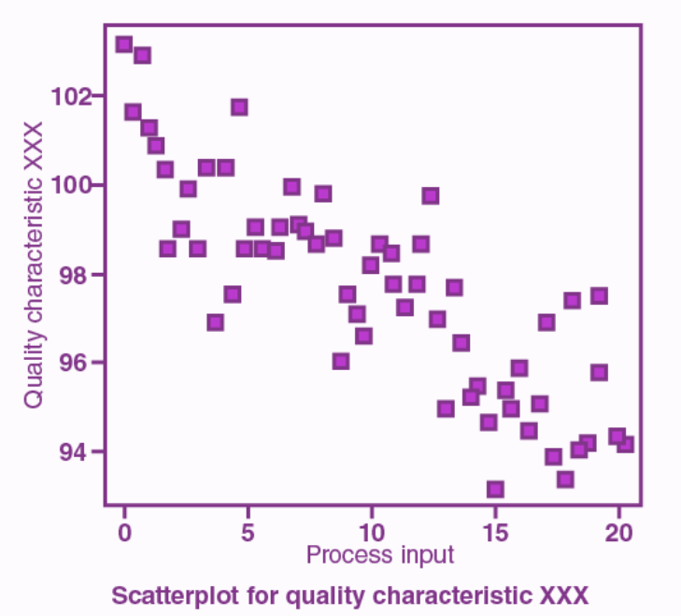

Slide 33
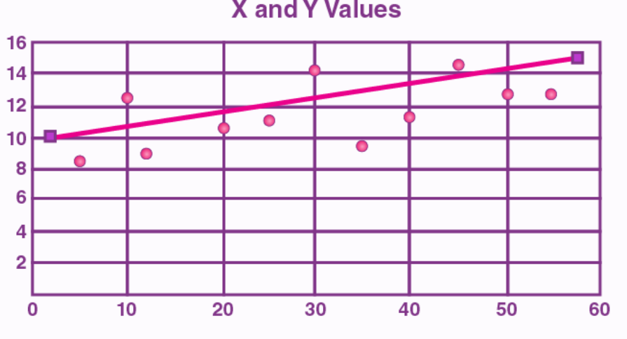
“line of best fit” or “trend line“
The line drawn in a scatter plot, which is near to almost all the points in the plot is known as “line of best fit” or “trend line“

Slide 34
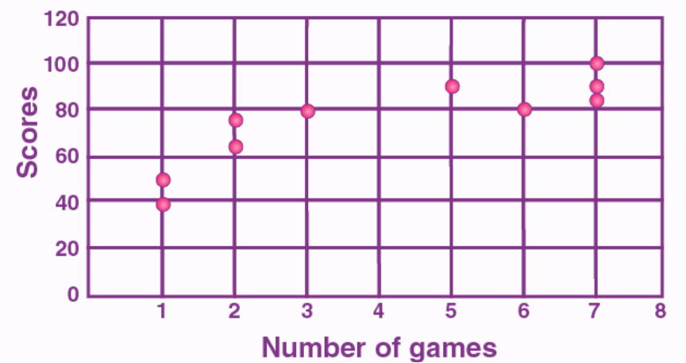
Example of Draw Scatter Plot
Draw a scatter plot for the given data that shows the number of games played and scores obtained in each instance.
No. of games | 3 | 5 | 2 | 6 | 7 | 1 | 2 | 7 | 1 | 7
Scores | 80 | 90 | 75 | 80 | 90 | 50 | 65 | 85 | 40 | 100

Slide 35
Pros of Scatter Plot
Visualizing Relationships: Scatter plots effectively show the relationship between two continuous variables. They help identify patterns, trends, clusters, and correlations between the variables.
Identification of Outliers: Scatter plots make outliers (unusual data points) easily noticeable as they stand out from the main cluster of points, aiding in anomaly detection.
Correlation Assessment: Scatter plots allow for a visual assessment of the direction and strength of correlation between variables. The pattern of points (positive, negative, or no correlation) provides insights.
Contextualization: Scatter plots help in understanding how changes in one variable affect another. This is particularly useful when making predictions or drawing causal relationships.
Visualizing Multivariate Data: By using color, shape, or size to represent a third variable, scatter plots can help visualize the relationship between three or more variables in a single plot.
Comparisons: Scatter plots enable easy comparison between multiple datasets, helping to identify similarities and differences in their relationships.

Slide 36
Cons of Scatter Plot
Limited for Categorical Data: Scatter plots are designed for numerical variables, so they're not suitable for visualizing relationships involving categorical variables.
Overplotting: When data points heavily overlap, it can lead to overplotting, where individual points are indistinguishable. This can hinder interpretation, especially with large datasets.
No Causation Inference: Although scatter plots show relationships, they do not establish causation. A strong correlation doesn't necessarily mean one variable causes the other.
Non-Linear Relationships: If the relationship between variables is non-linear, a scatter plot might not reveal the true pattern without further analysis or transformations.
Missing Context: Scatter plots might lack context, such as labels, titles, or axis descriptions. This can make them confusing or less informative for viewers who are unfamiliar with the data.
Limited for Time Series Data: While scatter plots can show relationships at a single point in time, they might not capture temporal trends in time series data effectively.
Bias from Scaling: The appearance of the plot can be influenced by the scaling of the axes. Changing the axis limits can distort the visual perception of the relationship.

Slide 37
Pair Plot

Slide 38
Pair Plot
Pair plot is used to understand the best set of features to explain a relationship between two variables or to form the most separated clusters.
It also helps to form some simple classification models by drawing some simple lines or make linear separation in our data-set.

Slide 39
What is Pair Plot?
A pair plot, also known as a scatterplot matrix, is a visualization technique that displays pairwise scatter plots of multiple variables in a dataset.
It allows you to quickly assess the relationships between multiple numerical variables and can be especially useful for exploring correlations and patterns within the data.
Each scatter plot in a pair plot shows the relationship between two variables, and the diagonal of the matrix typically displays histograms or density plots for each individual variable.

Slide 40
Python code to draw Pair Plot for Iris Dataset
import seaborn as sns
import matplotlib.pyplot as plt
# Load a sample dataset from Seaborn
iris = sns.load_dataset("iris")
# Create a pair plot
sns.pairplot(iris, hue="species")
# Color the points based on the "species" column
plt.show()

Slide 41
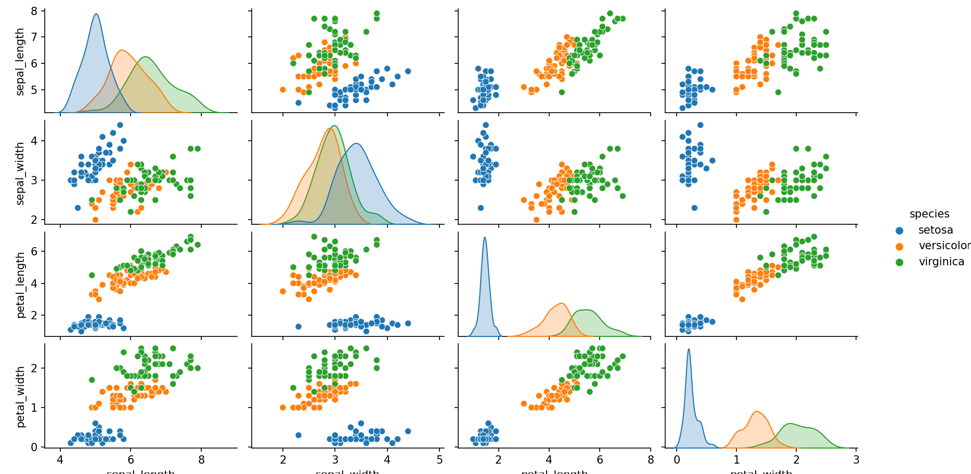
Output of the code- Pair Plot

Slide 42
Pros Pair Plot
Multivariate Exploration: Pair plots provide a comprehensive view of relationships between multiple numerical variables in a dataset. This is particularly valuable for exploring how variables interact with each other.
Quick Insights: They allow you to quickly identify patterns, trends, correlations, and potential outliers within the data. This can serve as an initial step in data analysis.
Correlation Assessment: Pair plots are excellent for assessing the strength and direction of relationships between variables. Positive, negative, or no correlation can be visually observed.
Visualization of Distribution: The diagonal elements of the matrix typically contain histograms or density plots, allowing you to see the distribution of each variable in addition to its relationships with others.
Facet Options: You can use color or other visual cues to add additional information to the scatter plots, making it possible to visualize relationships in the context of categorical variables.
Compact Presentation: Despite considering multiple relationships, pair plots offer a compact and organized layout, helping you identify interesting areas for further investigation.

Slide 43
Cons Pair Plot
Complexity with Large Datasets: Pair plots can become overwhelming when dealing with a large number of variables. The number of scatter plots grows exponentially with the number of variables, leading to a cluttered appearance.
Not Suitable for Categorical Data: Pair plots are designed for numerical variables and might not be appropriate for visualizing relationships involving categorical variables.
Non-Linear Relationships: Pair plots are best suited for capturing linear relationships. Non-linear relationships might not be evident, requiring additional transformations or analyses.
Limited Insights into Multivariate Interactions: While pair plots offer insights into pairwise relationships, they might not fully reveal complex interactions among three or more variables.
Inability to Establish Causation: Correlation does not imply causation. Pair plots can show associations between variables but cannot establish causal relationships.
Interpretation Challenges: Interpreting a large number of scatter plots requires careful attention, and meaningful insights might require domain knowledge or statistical analysis.

Slide 44
Thank You!!!

